Slide 1
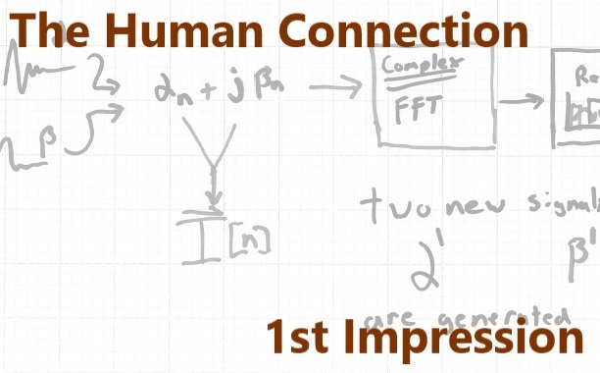

Eli Hughes
The Hackaday Prize - 2014

Slide 3




Slide 4


Slide 5




Slide 6


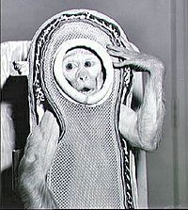

Slide 7





Slide 8






Slide 9

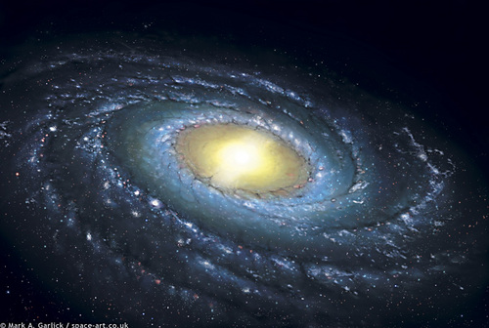

Slide 10






Slide 12
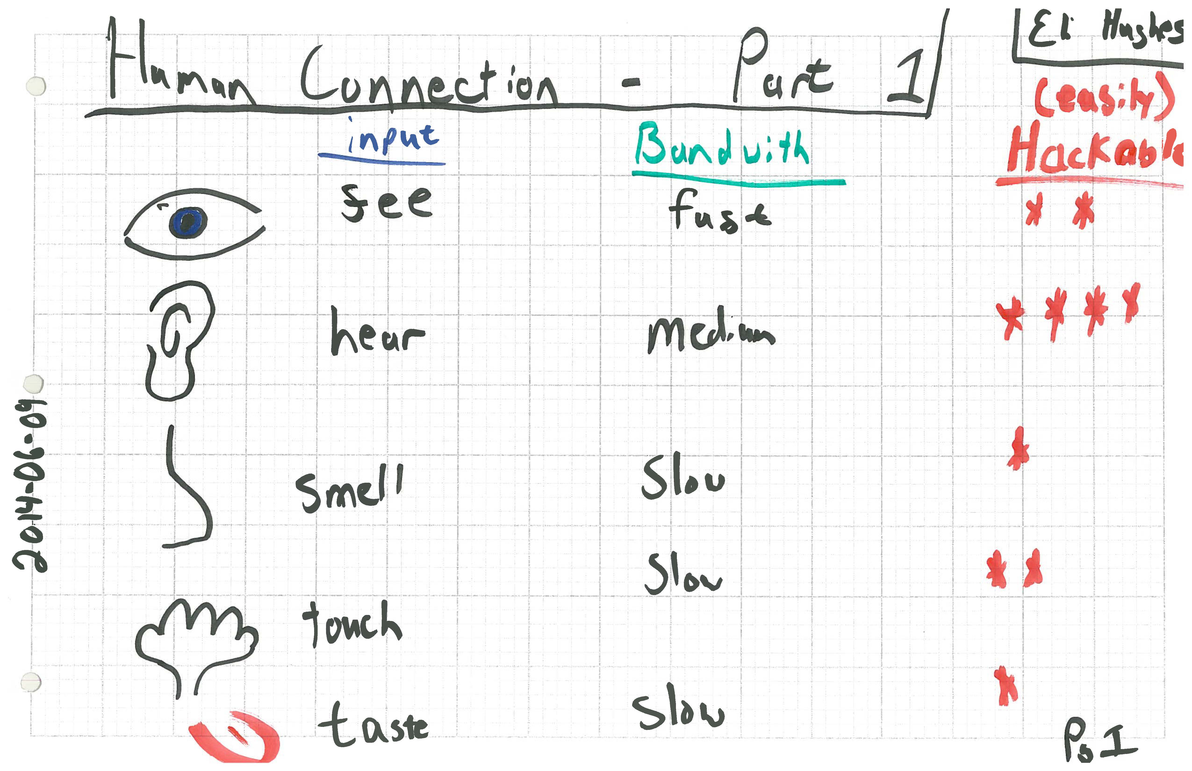

Slide 13
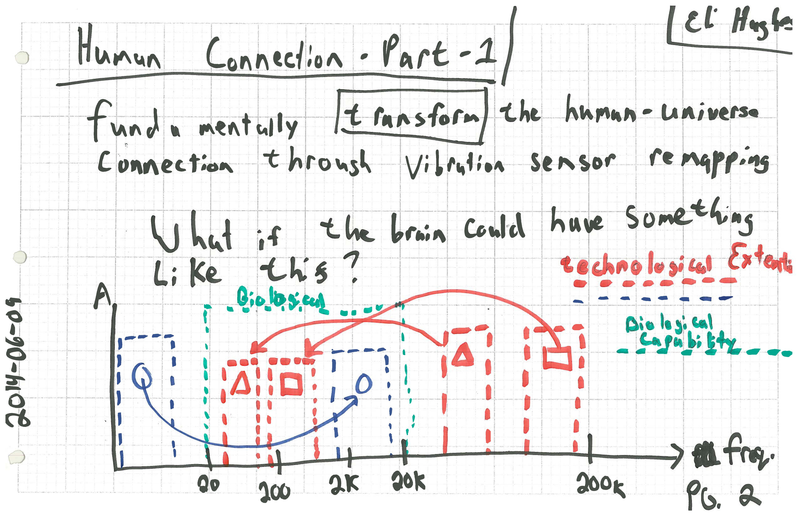

Slide 14
What if we could do non-linear remapping of entire bands. I.e. move 30Khz-70Khz into a 3-4Khz Band?
What would the brain do with OFDM patterns?

Slide 15
What about moving infrasonic in to the more sensitive bands of the ear?

Slide 16
What about a DIRECT NEURAL connection of sound into the brain?

Slide 17
What would the oceans under the ice of Europa sound like?
who use the ultrasonic or infrasonic band

Slide 18
Can we communicate with other entities? who use the ultrasonic or infrasonic band

Slide 19
Star Trek IV Scene here

Slide 20
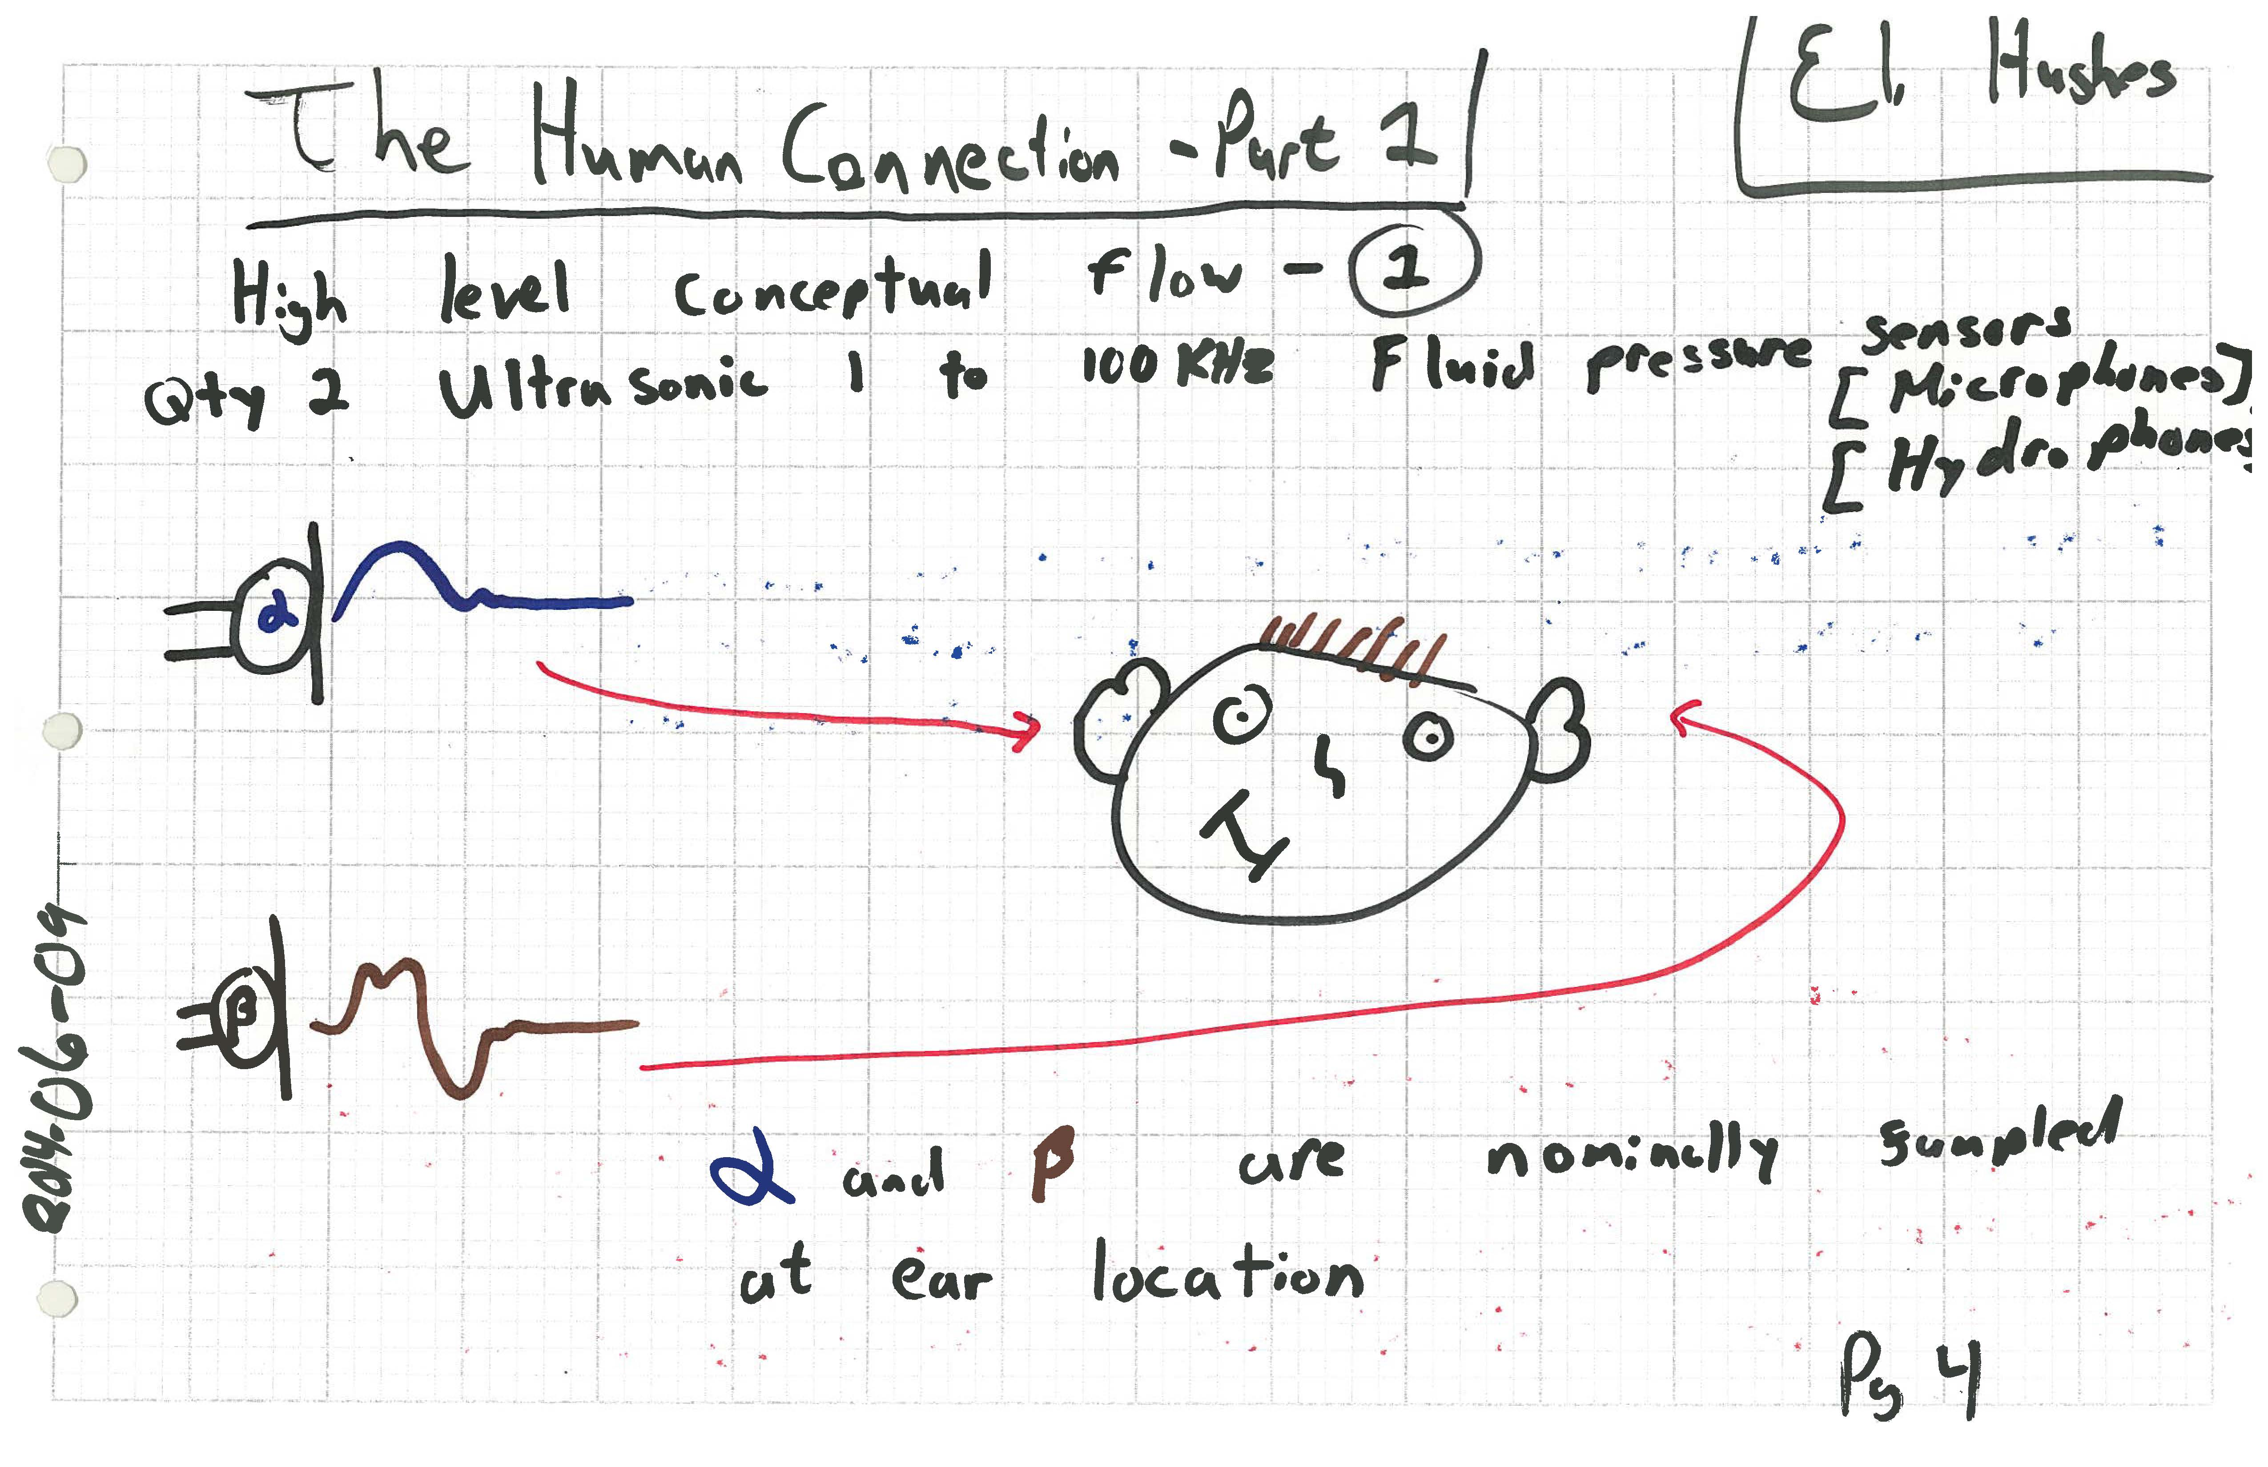
Star Trek IV Scene here

Slide 21
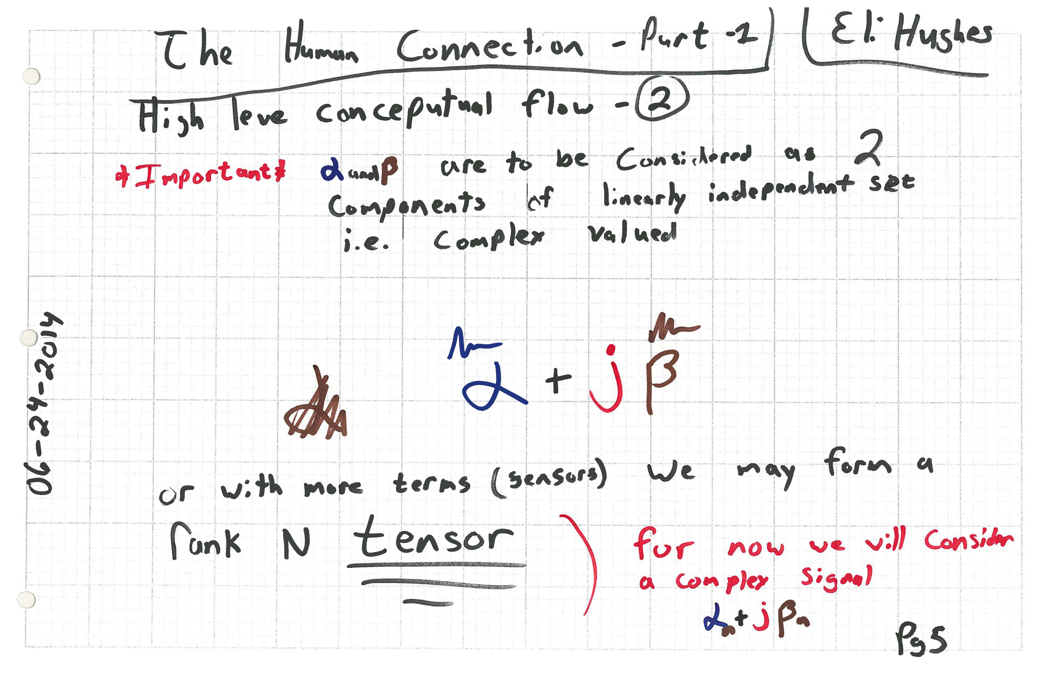

Slide 22
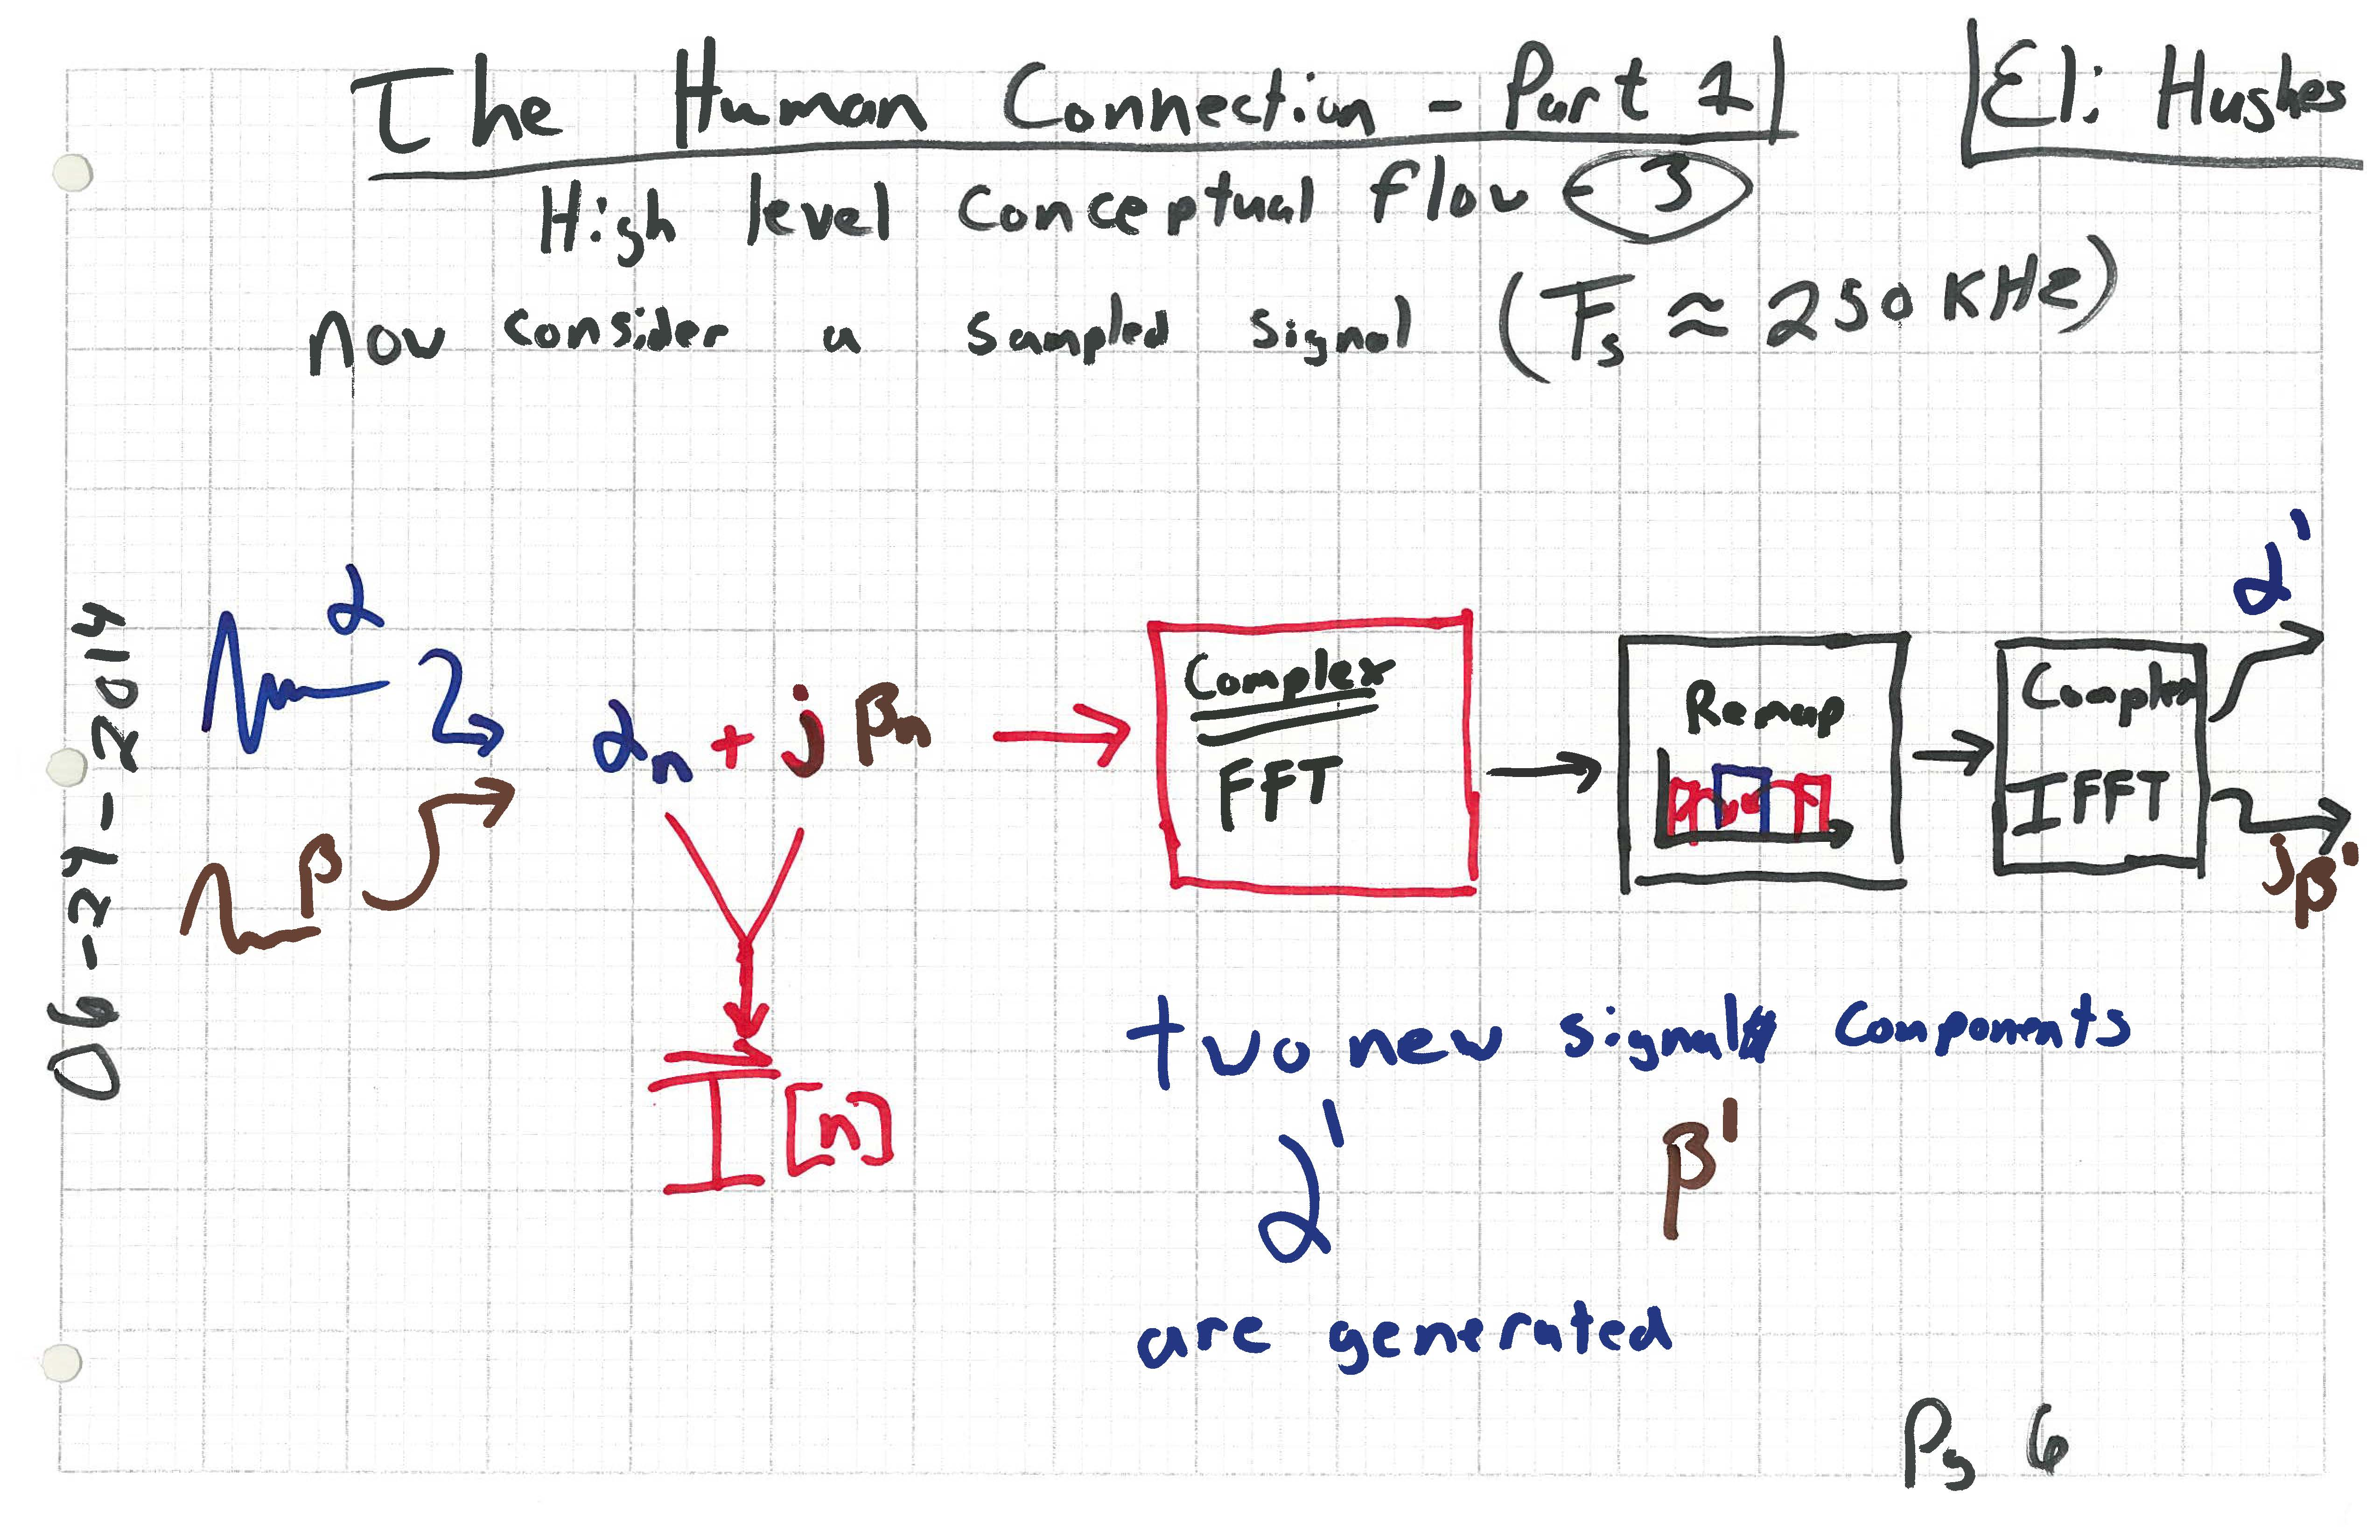

Slide 24


Slide 25
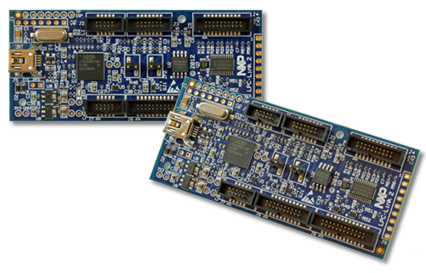
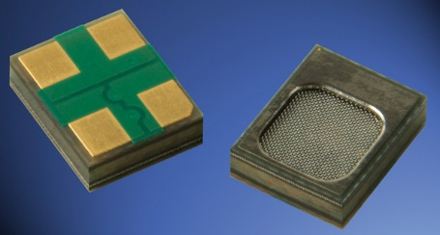


Knowles Acoustics – Ultrasonic MEMS Mics
LPC-LINK-2 as dev board → $20
Triple Core M4-M0-M0
204MHz - Lots of HP!
Hardware To Fab:
MEMS Carrier/Preamp PCBs
LPC-Link-2 Interface PCB

